Slide 1
Track C Rapporteur Summary Epidemiology and Prevention Research
Asa Radix, MD, MPH
Callen-Lorde Community Health Center
United States

Slide 2
Track C Team
Asa Radix, Ayden Scheim, Tonia Poteat, Pedro Carneiro, Michael Marco

Slide 3
Outline
Mortality trends
Biomedical interventions
TasP
PrEP
Rapid and same day ART
Addressing syndemics
Key Population-led interventions

Slide 4
Mortality Trends in the ART Era (TUPDC01)
Canadian HIV Women's Sexual and Reproductive Health Cohort Study (CHIWOS) - TUPDC0102
Mortality rate 4.5 x higher than gen pop
Risk factors: Current alcohol, tobacco use, depression
Cancer/cardiovascular dis (15%), drug/alcohol use (11%)
HIV treatment factors (ART use, VL, CD4) NOT predictive
London Mortality Study Group – (TUPDC0106)
Risk factors: alcohol and tobacco use
Non-AIDS malignancies were the leading cause of death

Slide 5
Does U=U?
PARTNER2 (WEAX0104LB)
Estimate of transmission risk in serodifferent gay couples when the HIV-positive partner is virally suppressed
783 gay couples (median 1.6 years of follow-up)
The ability to phylogenetically link transmissions during eligible CYFU
Among serodifferent gay couples who had sex ~77,000 times without condoms with undetectable viral load (<200 copies), there were zero phylogenetically-linked transmissions during ~1600 CYFU
Results indicate that the risk of HIV transmission when HIV viral load is suppressed is effectively zero
Undetectable = Untransmissable!

Slide 6
PrEP
ANRS Prevenir (WEAE0406LB)
1,594 participants (98.9% MSM) onto PrEP
Daily (45.4%) and on-demand PrEP(54.6%) offered to eligible participants
To date, HIV incidence in both the daily and on-demand group has been zero
No participant has discontinued PrEP due to drug-related adverse events

Slide 7
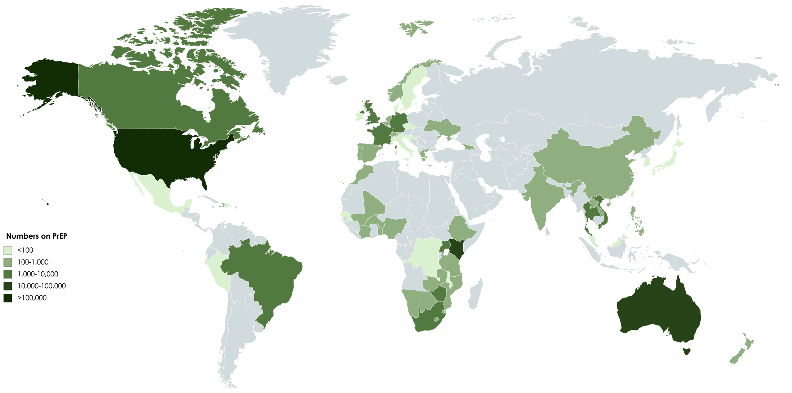
Oral PrEP Global Roll-out in 2018
1,100
225,000
700
Est. numbers on PrEP:
<100
1,500
100 - 1,000
14,600
1,000 – 10,000
10,000 – 100,000
>100,000
The Politics of PrEP THSY02: Jean-Michel Molina
Data from AVAC.org 2018 - https://www.prepwatch.org/country-updates/

Slide 8
PrEP in the real world (TUPDX01)
Increased scale-up for PEPFAR funded programs FSW, MSM,TG
Less condom use with casual partners among MSM in Melbourne
PrEP as harm reduction “MTV”
Elevated HCV and re-HCV Netherlands
Feminizing hormones and PrEP – results from 2 studies
lower plasma TFV exposure (13%) in the presence of FHT
Altered TDF/FTC pharmacology in rectum

Slide 9
Rapid and same-day ART initiation
Rapid and same-day initiation of ART is achievable in LMIC settings, when services are delivered in accessible community settings.
The CommLink program in eSwatini (including community-based testing, mobile care, and peer-based linkage) achieved 96% ART initiation, and 73% rapid initiation (Williams, THAC0201)
Implementing fast-track ART initiation in Botswana improved median time from linkage to first viral suppression from 210 to 104 days (Lebelonyane, THAC0204)
At a Bangkok sexual health clinic, 79% of diagnosed patients received same-day ART and were 2.2 times as likely to be virally supressed vs. standard of care (Seekaew, THAC0203)

Slide 10
KP-led services
Services led by peers and KP CBOs increase access to HIV prevention and treatment
More than half of people tested by KP CBOs in Vietnam were first-time testers, and 90% of those diagnosed enrolled in treatment (Ngo, THAC0202)
In Malawi, HCP training and differentiated service delivery increased case finding and linkage among FSW and MSM (Kamanga, THAC0201)
At a Bangkok sexual health clinic employing KP staff, 79% of diagnosed patients received same-day ART and 90% were successfully referred to long-term ART care (Seekaew, THAC0203).
Differentiated services to address unique needs of KPs
At Bangkok’s Tangerine Clinic, TGW accessing hormone therapy were more likely to repeatedly test for HIV and to access PrEP (Janamnuaysook, THAC0204)

Slide 11
Syndemics
Co-occurring psychosocial conditions that interact synergistically to exacerbate the risk for HIV transmission
Multi-component interventions often fail to address social forces beyond the individual level and are often limited to one disease/condition
Recognize social and political forces that drive structural vulnerabilities
Requires systems thinking for which there may be limited experience and/or political will
When fully applied, can promote interventions at the policy as well as clinical and individual levels

Slide 12
Syndemic Interventions
India Integrated Bio-Behavioural Surveillance (men)
Alcohol use, drug use and violence victimisation (physical and/or sexual violence in the past year) predicted condom use
Women’s Health Coop (WHC+)
intervention impacted drinking, IPV, condom use, ARV adherence
Project IMPACT (USA)
CM using MSM enrolled in RCT using behavioral activation
intervention participants reported fewer CAS acts with men who were HIV-infected or status unknown
fewer CAS acts under the influence of CM with men who were HIV-infected or status unknown
More continuous days abstaining from crystal methamphetamine

Slide 13
Transgender Populations
New data on drug-drug interactions between PrEP and feminizing gender affirming hormone therapy. Clinical significance unclear
Transgender populations not mentioned in most presentations that were not transgender specific or KP focused
No oral presentations specific to transgender men

Slide 14
More than just ART..
Address tobacco, substance use, depression in people living with HIV
U=U, but requires scaleup in LMICs
PrEP
Intervene with syndemics
Rapid start
KP-led interventions are crucial

Slide 15
Thank You
Special thanks to Lorraine Mangwiro!

